Slide 1
Convolutional Neural Network
Presentor: Krish C Naik

Slide 2
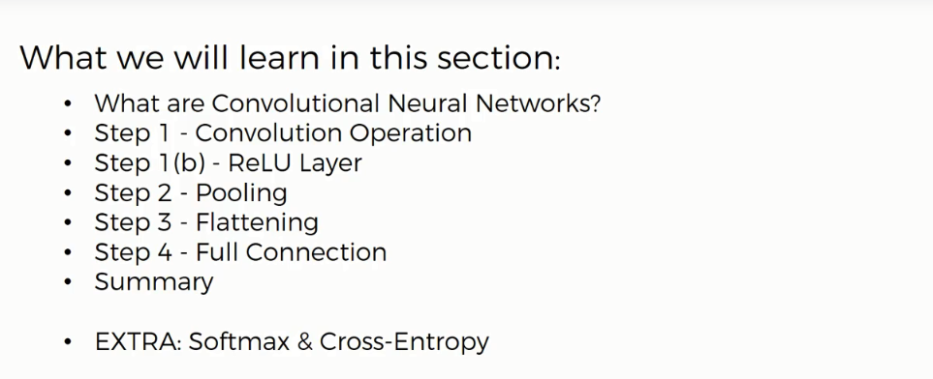

Slide 3
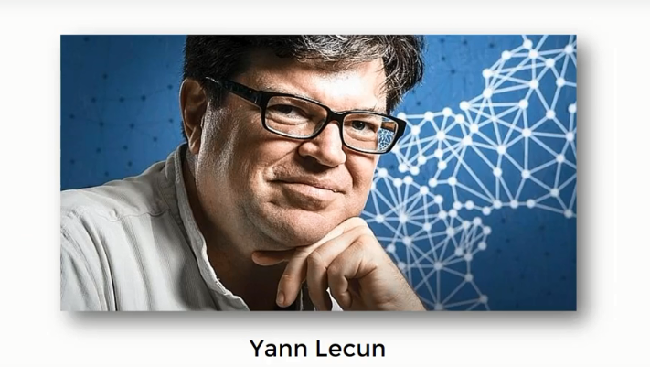

Slide 4
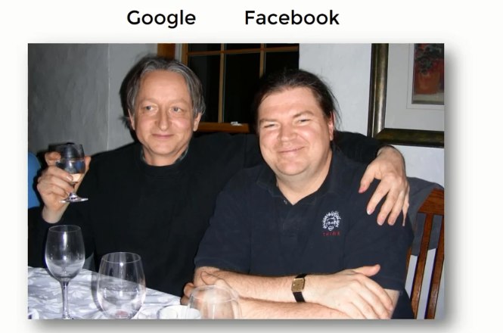

Slide 5
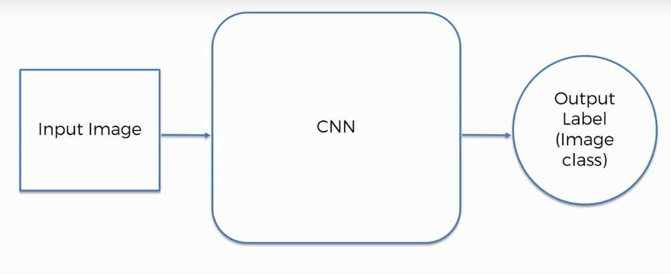
Convolutional Neural Network

Slide 6
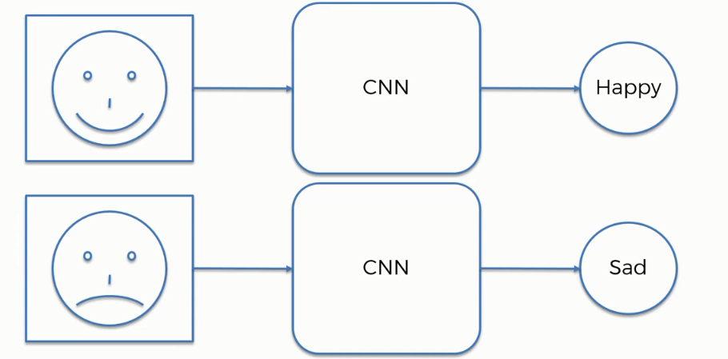
Convolutional Neural Network

Slide 7
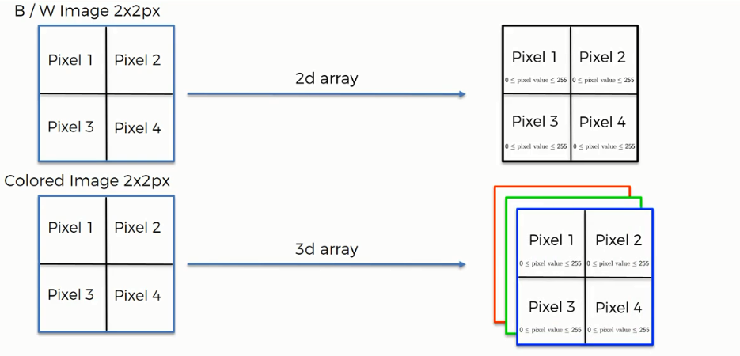
Convolutional Neural Network

Slide 8
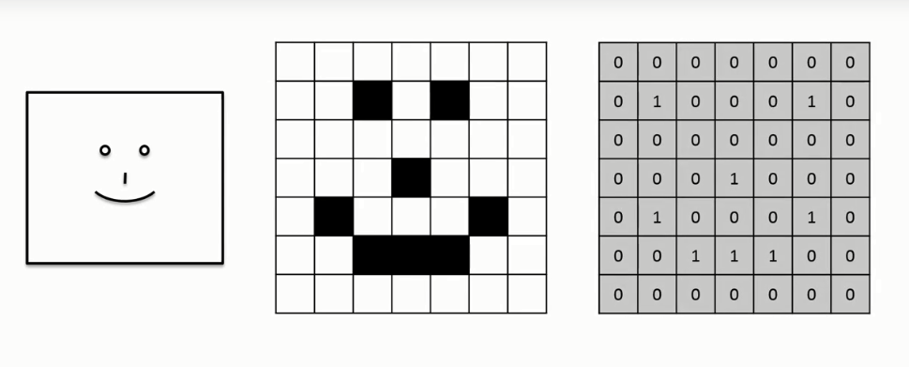
Convolutional Neural Network

Slide 9
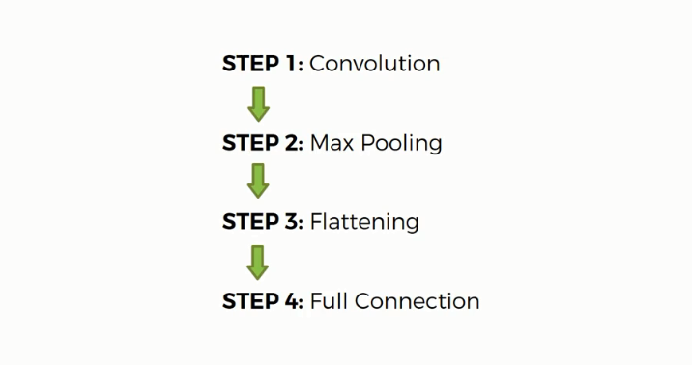

Convolutional Neural Network

Slide 10

Convolutional Neural Network

Slide 11
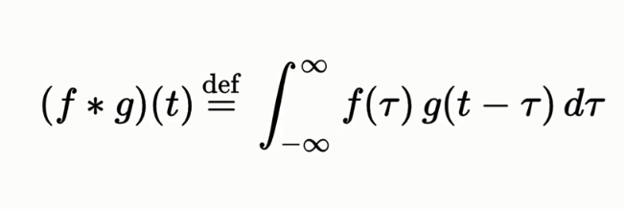
Step1- Convolution

Slide 12
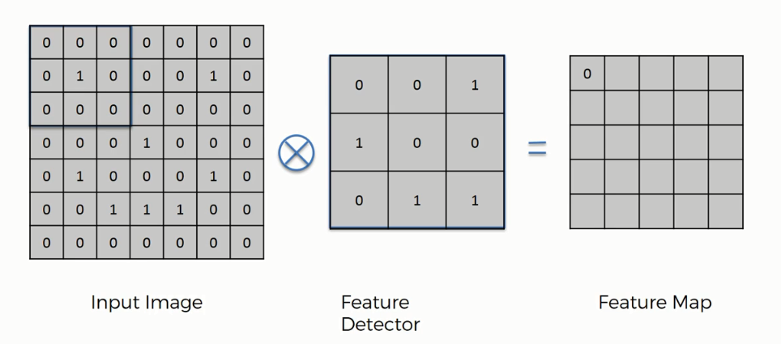
Step1-Convolution

Slide 13
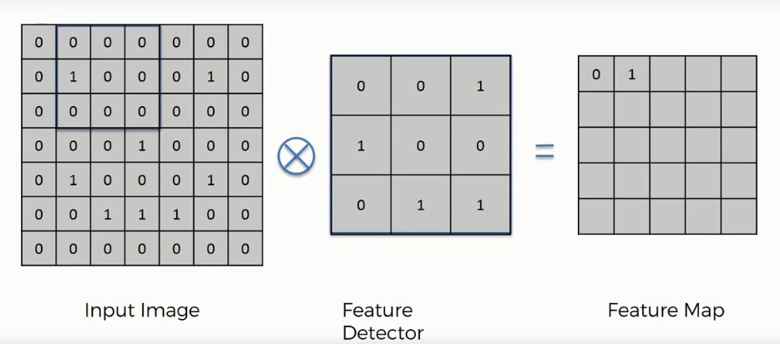
Step1-Convolution

Slide 14
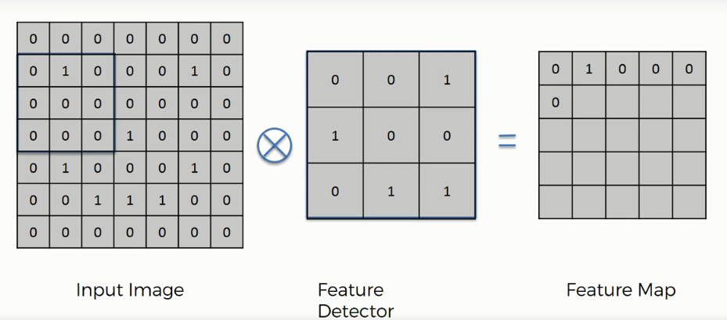
Step1-Convolution

Slide 15
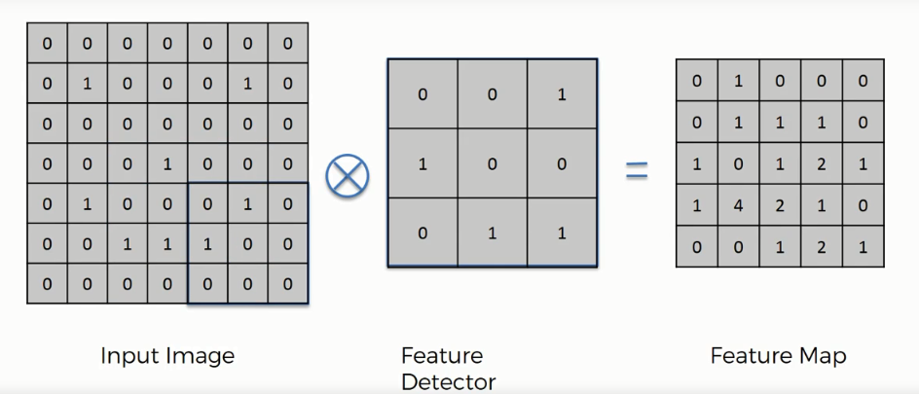
Step1-Convolution

Slide 16
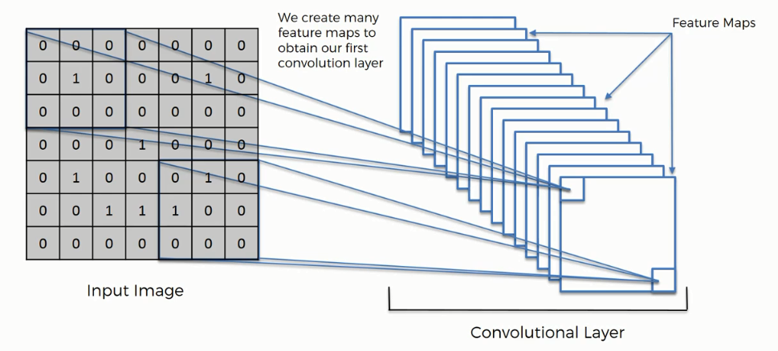
Step-1 Convolution

Slide 17
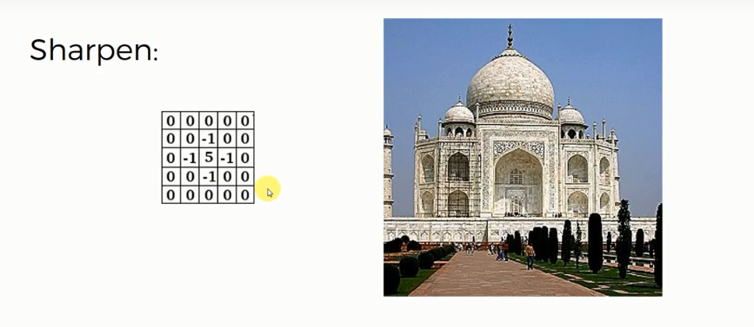
Filters

Slide 18
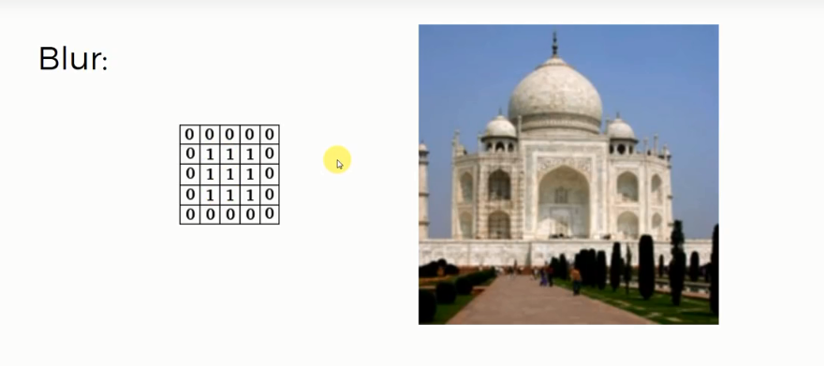
Filters

Slide 19
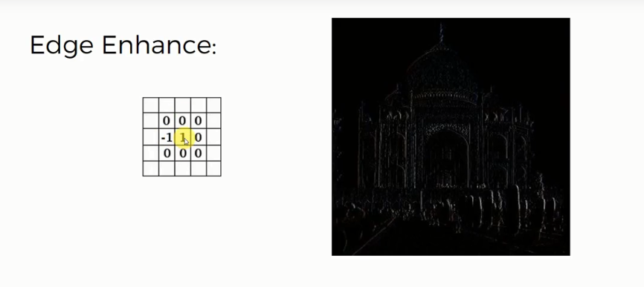
Filters

Slide 20
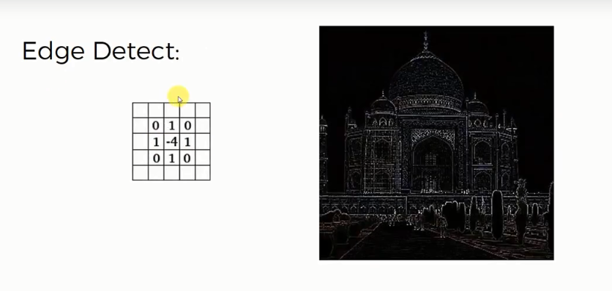
Filters

Slide 21
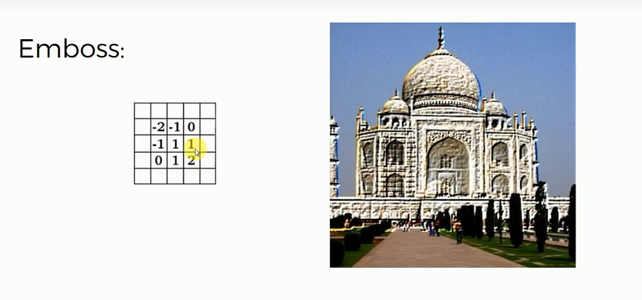
Filters

Slide 22
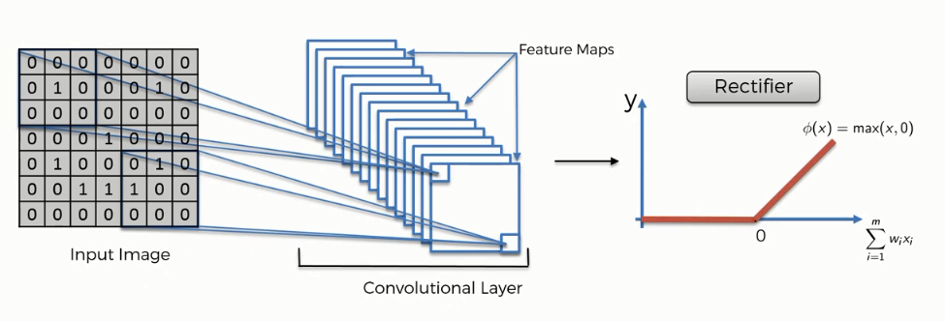
Step1(b)-ReLU Layer

Slide 23
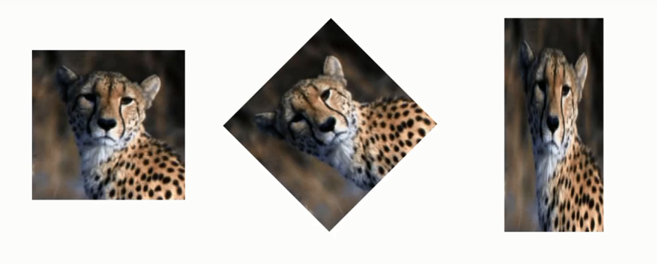
Step2- Pooling

Slide 24
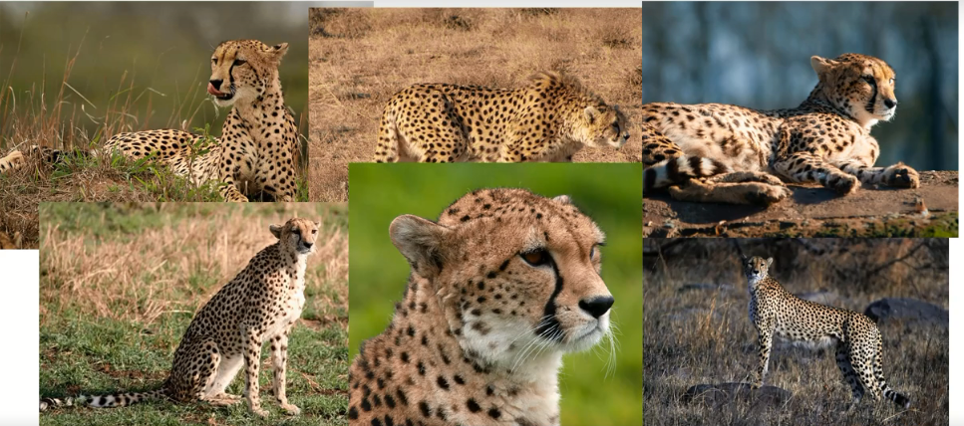
Step2- Pooling

Slide 25
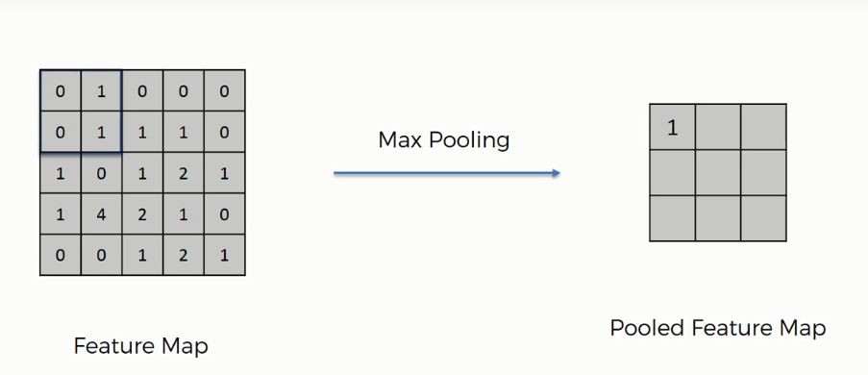
Step2-Max pooling

Slide 26
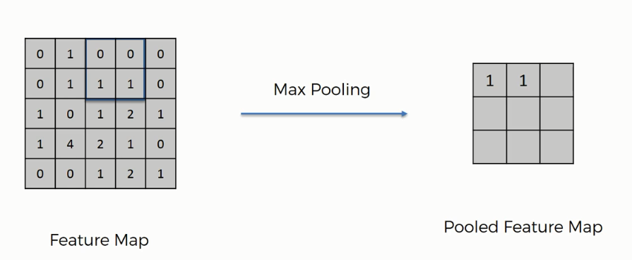
Step2-Max Pooling

Slide 27
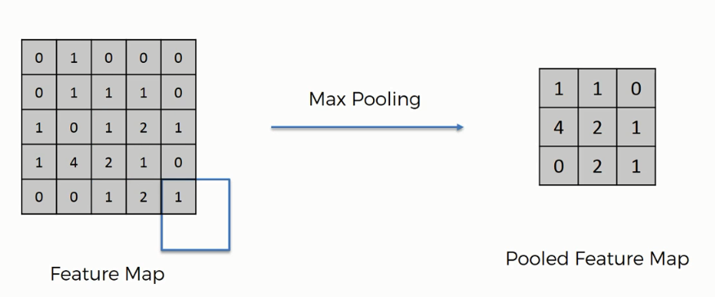
Step2- Max Pooling

Slide 28
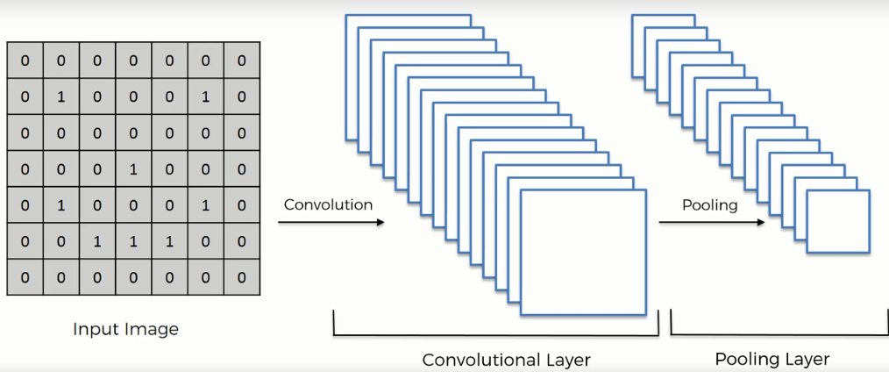
Convolution Layer

Slide 29
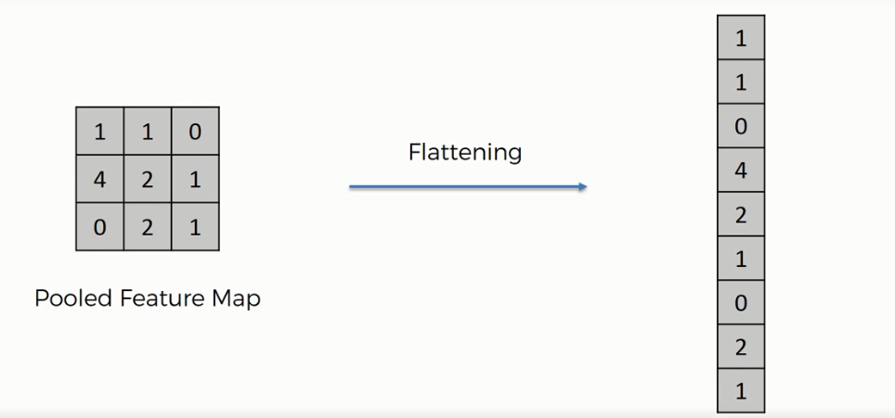
Flattening

Slide 30
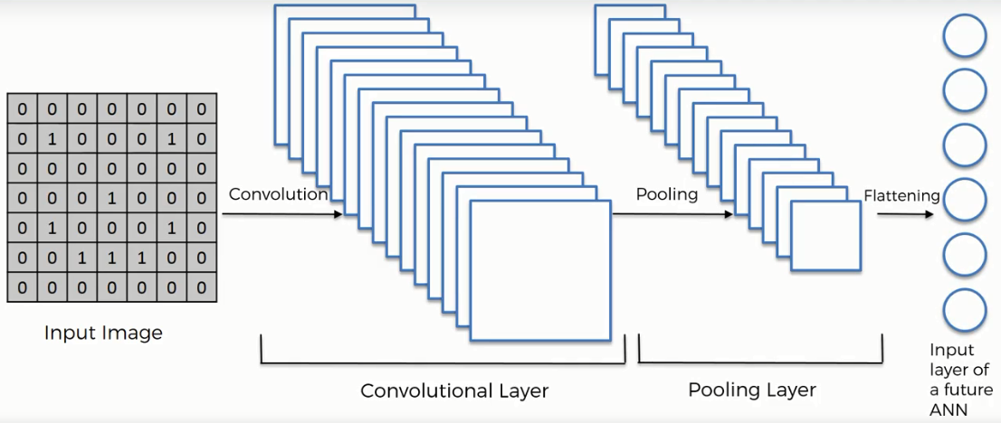
Convolutional Layer

